Slide 1
클라우드 컴퓨팅

Slide 2
목차
Container – Where is my data?
Docker: Volume
Assignment 2
Operate Service
Kubernetes
Settings

Slide 3

Container – Where is my data?
Assume that operating WordPress in a container. Where are my posts stored?

Slide 4

Container – Where is my data?
Probably stored in the DBMS (in another container).
But I mean, where is it stored on host File System?

Slide 5
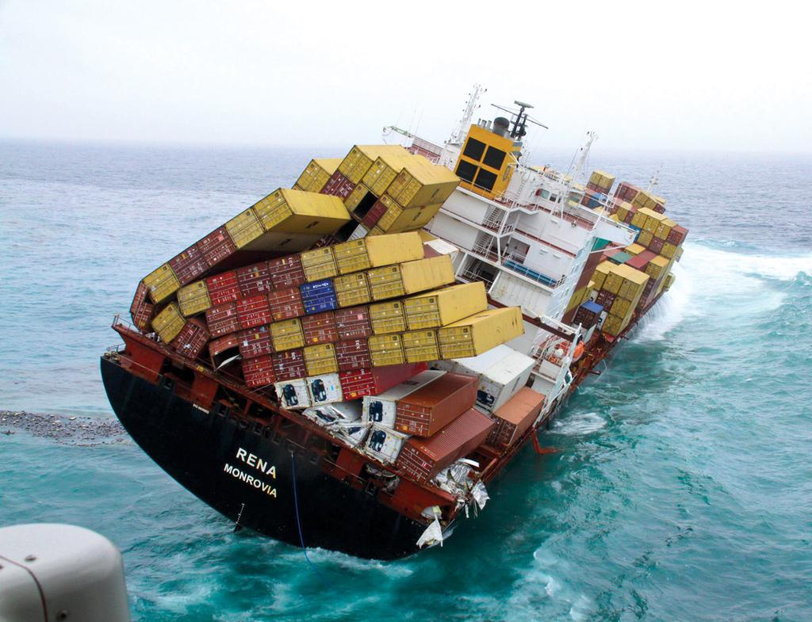

Container – Where is my data?
$ docker rm DBMS:curr
$ docker run DBMS:next
https://www.google.co.kr/search?q=mv+rena

Slide 6
Docker
$ docker stop $(docker ps -a -q)
$ docker run --rm -d hello:0.1
a58943baec9b...
$ docker inspect {your container ID} \
| grep IPAddress
"SecondaryIPAddresses": null,
"IPAddress": "172.17.0.2",
"IPAddress": "172.17.0.2",

Slide 7
Docker
$ curl http://172.17.0.2:8080/hello
1537374311479,hello
$ curl http://172.17.0.2:8080/aloha
1537374311479,hello
1537374314695,aloha
$ curl http://172.17.0.2:8080/bonjour
1537374314695,aloha
1537374321238,bonjour
hello:0.1 stores
logs at /data/.last

Slide 8
Docker
Container Layer
Thin R/W layer
b12c48a54d09...
CMD
cfa9be2948f7...
EXPOSE
72d445df59a4...
RUN
69e216d2f92a...
COPY
Image Layers (R/O)
8c9da153728a...
WORKDIR
df48b68da02a...
<missing>
...
<missing>

Slide 9
Docker
$ docker inspect {your container ID} \
| grep Pid
"Pid": 24847,
"PidMode": "",
"PidsLimit": 0,
$ cat /proc/{your container PID}/root/data \ ./last
1537374321238,bonjour

Slide 10
Docker
So, whenever I update it, should I back it up with this command?
$ docker inspect $(docker ps -q -f \
“name=DBMS”) | grep Pid
$ cp -r /proc/{container PID}/root \ ./backup
How do I store my data directly on host storage?

Slide 11
Docker: Volume
$ docker volume create world
$ docker volume ls
DRIVER VOLUME NAME
local world

Slide 12
Docker: Volume
$ docker run --rm -d \
--mount src=world,dst=/data hello:0.1
Directory to be mounted
in container
Option: mount volume
Name of the volume

Slide 13
Docker: Volume
$ docker run --rm -d \
--mount src=world,dst=/data hello:0.1
72109a8ad19e...
$ curl http://172.17.0.2:8080/hola
1537379433391,hola

Slide 14
Docker: Volume
$ docker stop {your container ID}
$ docker run --rm -d --mount \
src=world,dst=/data hello:0.1
d5c12ec2280d...
$ curl http://172.17.0.2:8080/ciao
1537379433391,hola
1537379703104,ciao

Slide 15
Docker: Volume
$ docker volume inspect world \
| grep Mountpoint
"Mountpoint": "/var/lib/docker/volumes/world/_data"
$ cat /var/lib/docker/volumes\
/world/_data/.last
1537379703104,ciao

Slide 16
Docker: log
$ docker ps
d5c12ec2280d...
$ docker logs {your container ID}
> hello-docker@1.0.0 start /usr/src/app
> node index.js
Running on http://0.0.0.0:8080
1537379703104,ciao

Slide 17
Assignment 2
Build an image that stores all the changing of .last file.
You can use any programming language including shell scripts.
Your Dockerfile must be start from official Docker image on the hub.
Example of a file you should store.
1537374311479,hello
1537374314695,aloha
1537374314695,aloha
1537374321238,bonjour
...
You cannot use DBMS.
Submit your source code including Dockerfile and instructions for how to run.
It is okay if messages are duplicated or missing.

Slide 18
Assignment 2
Build an image that records strings to .last file.
You can use any programming language including shell scripts.
Your Dockerfile must be start from official Docker image on the hub.
The generation of the string may be performed in any manner.
It should be compatible with the collector.
There is no issue (e.g. fail to write, missing writing, or etc.) when multiple containers trying to write. (optional)
Submit your source code including Dockerfile and instructions for how to run.

Slide 19
Service Operation

Slide 20

Service Operation
Scale-up

Slide 21
Service Operation
Scale-out

Slide 22


Service Operation
Internet
How about utilization?

Slide 23
Service Operation
Internet
Load Balancer

Slide 24

Service Operation
Internet
Load Balancer

Slide 25
Service Operation
Internet
Load Balancer

Slide 26
Service Operation
Internet
Load Balancer

Slide 27
Service Operation
Internet
Load Balancer

Slide 28
Service Operation
Which services are not enough resources?
Which services should be allocated first?
Which nodes are available?
Which nodes have enough space?
Which node did you move the service to?
Does the node that is determining this have enough resources?
So, is the service available now?

Slide 29

Kubernetes

Slide 30
Kubernetes
Kubernetes is an open-source system for automating deployment, scaling, and management of containerized applications.
It groups containers that make up an application into logical units for easy management and discovery. Kubernetes builds upon 15 years of experience of running production workloads at Google, combined with best-of-breed ideas and practices from the community.
https://kubernetes.io/

Slide 31
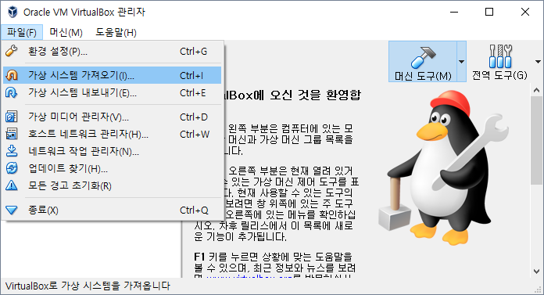
Setting: SSH
1. Click
2. Click

Slide 32
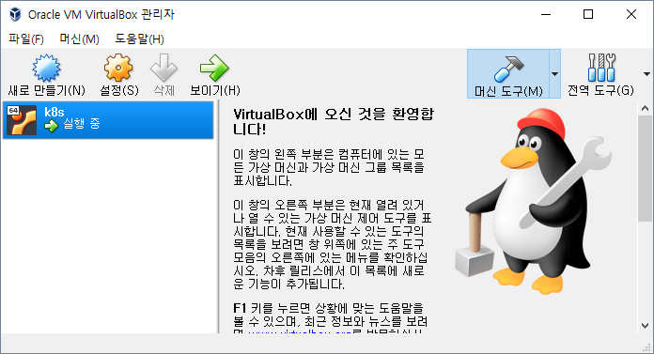
Setting: SSH
Right Click

Slide 33
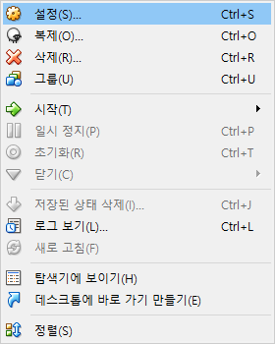
Setting: SSH
Click

Slide 34
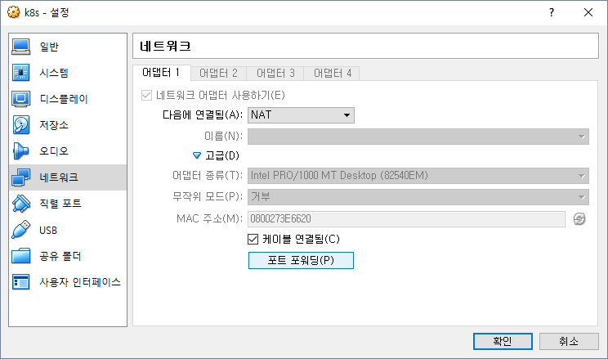
Setting: SSH
2. Click
1. Click
3. Click

Slide 35
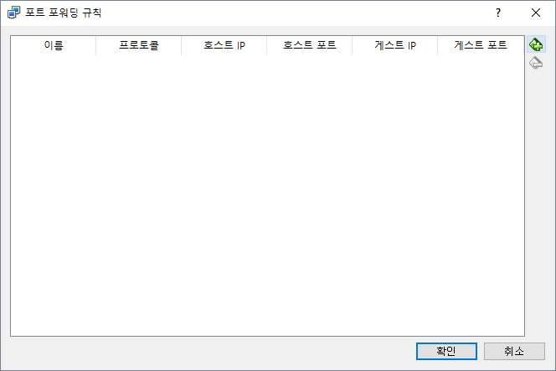
Setting: SSH
1. Click

Slide 36
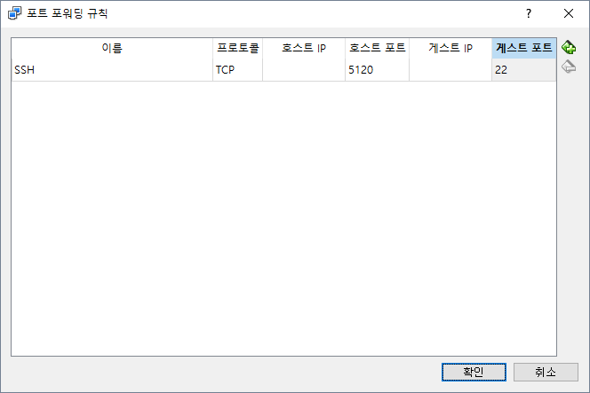
Setting: SSH
Host port as what you want
Guest port as 22
Click

Slide 37
Setting: SSH
Open cmd.exe or use PowerShell
# ssh k8s@localhost -p 5120

Slide 38
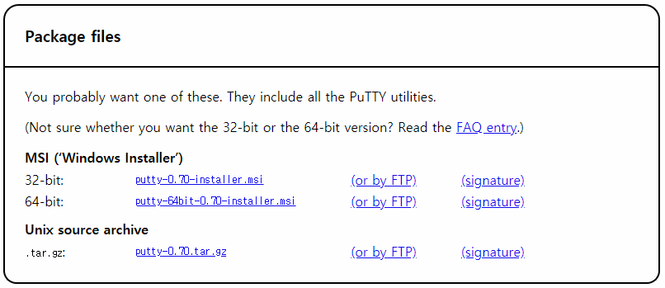
Setting: SSH
https://www.chiark.greenend.org.uk/~sgtatham/putty/latest.html

Slide 39
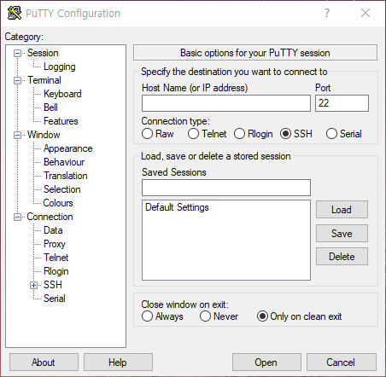
Setting: SSH

Slide 40
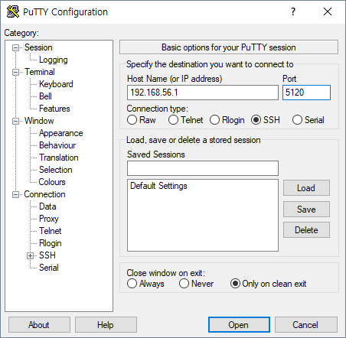
Setting: SSH
Insert Host Name and Port
2. Click

Slide 41
Setting: SSH
k8s@localhost's password:1234
Welcome to Ubuntu 18.04.1 LTS (GNU/Linux 4.15.0-38-generic x86_64)
…
k8s@k8s:~$

Slide 42
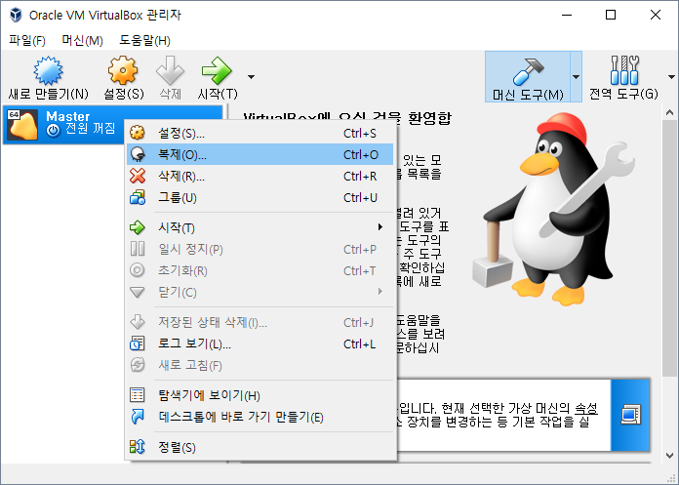
Setting: Clone VM
1. Close SSH and VM
2. Click

Slide 43
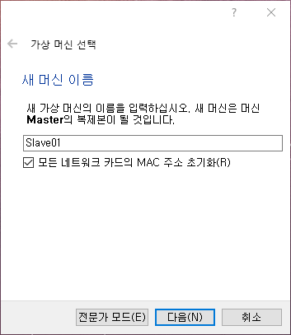
Setting: Clone VM
1. Set name and check
2. Click

Slide 44
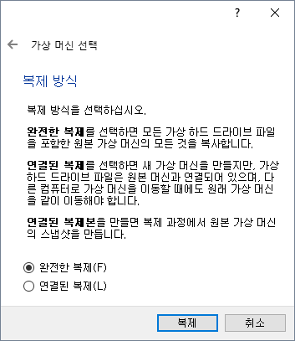
Setting: Clone VM
Wait for completion and perform one more clone for named “Slave02”
1. Click
2. Click

Slide 45
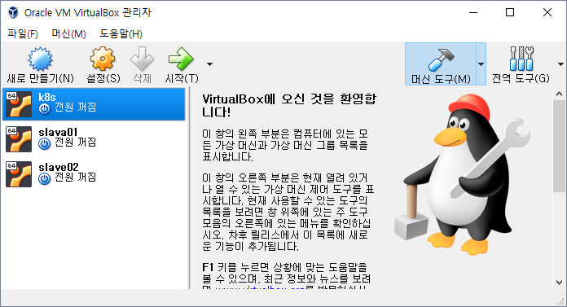
Setting: Clone VM

Slide 46
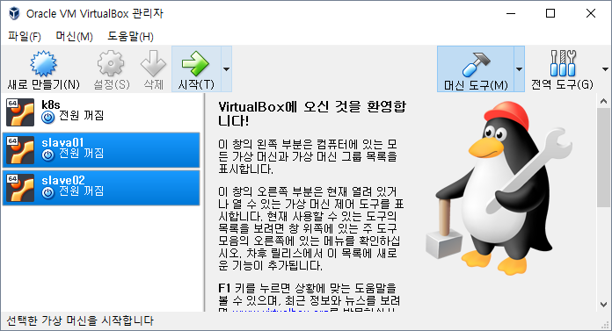
Setting: Config Slaves IP
Click

Slide 47
Setting: Config Slaves IP
k8s login: k8s
password: 1234
$ sudo su –
[sudo] password for k8s: 1234
$ vim /etc/netplan/50-cloud-init.yaml
... Enp0s3: address:
- 192.168.99.21/24 ...
$netplan apply
Slave 1 to 192.168.99.21/24
Slave 2 to 192.168.99.22/24

